Slide 1
Measuring DNS Flag Day 2020
Geoff Huston
Joao Damas
APNIC Labs

Slide 2
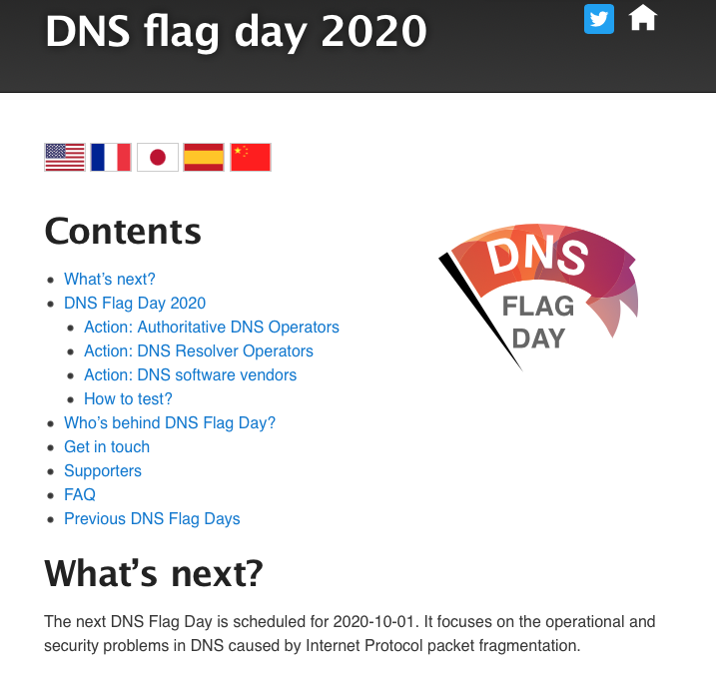
DNS Flag Day 2020

Slide 3
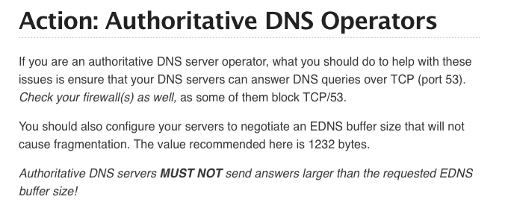
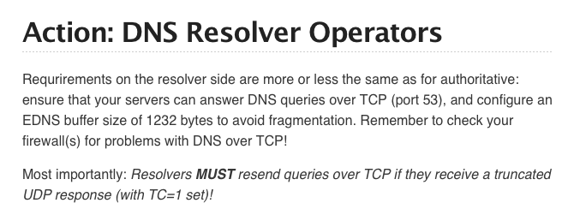
DNS Flag Day 2020

Slide 4
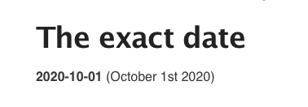
DNS Flag Day 2020

Slide 5
What Happened?
We’d like to look at two aspects of this work:
  What happened on 1 October 2020 (and thereafter) in the DNS?
  Is that recommended value of 1,232 just right? Too small? Too large?

Slide 6
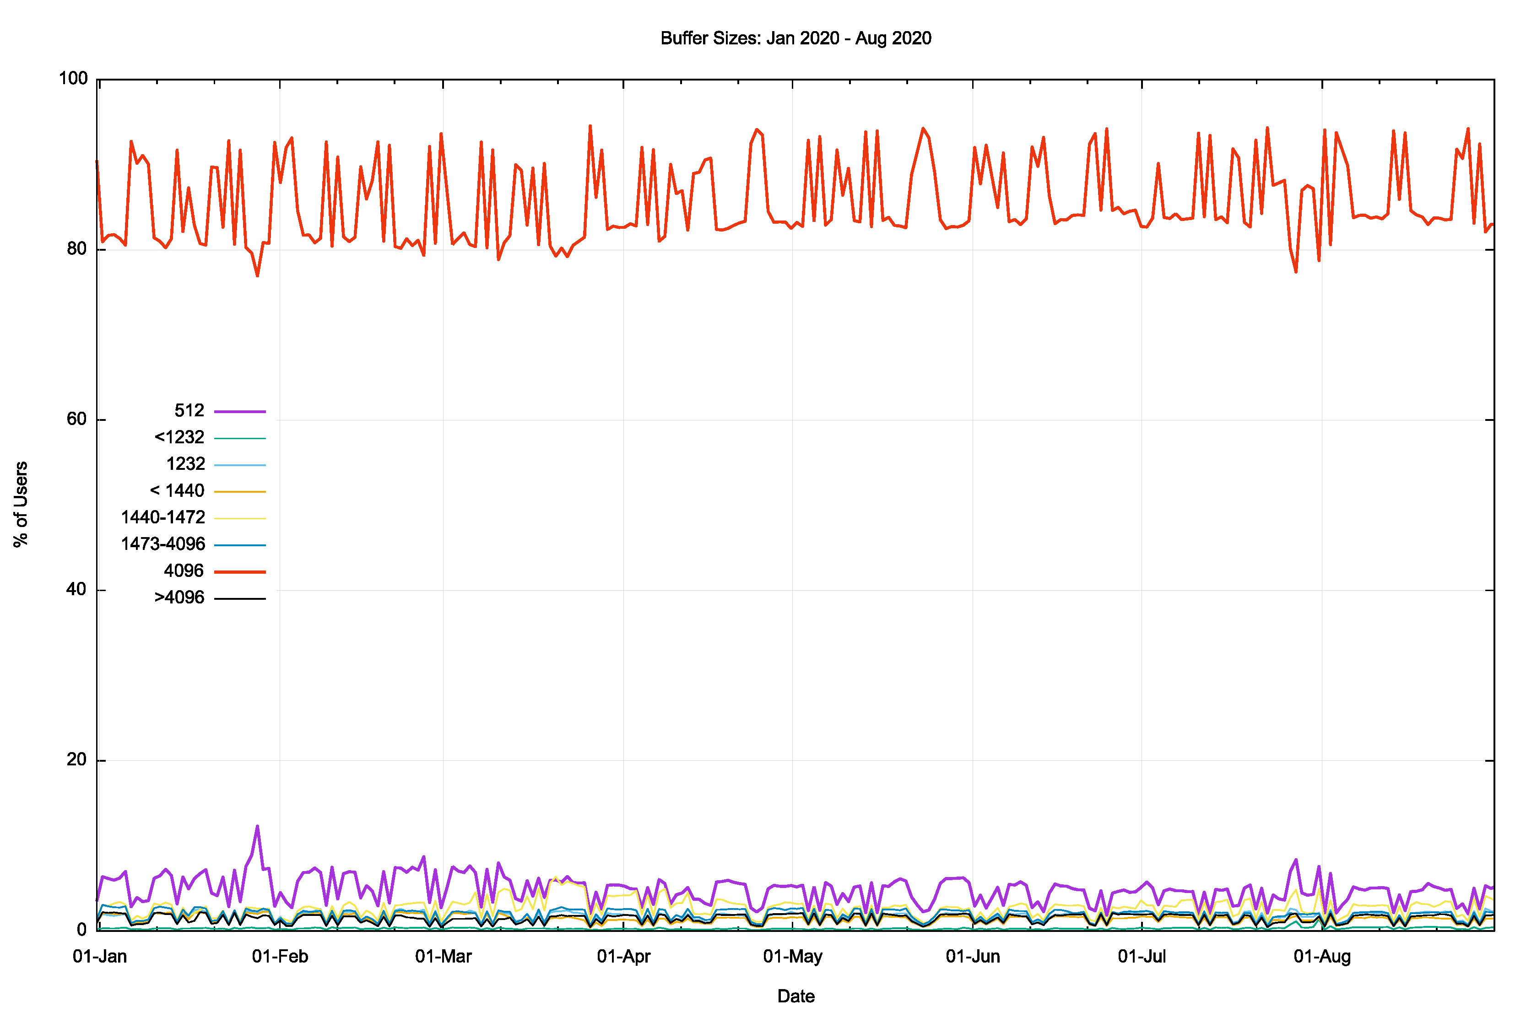
Looking at EDNS(0) Buffer Sizes
Jan 2020 – August 2020
4,096 used by queries from 80% - 95% of users
512 (no size specified) used by 10% of users
Weekday / Weekend profile suggesting a difference between enterprise and access ISP profiles
These results are from looking at queries between recursive resolvers and authoritative servers

Slide 7
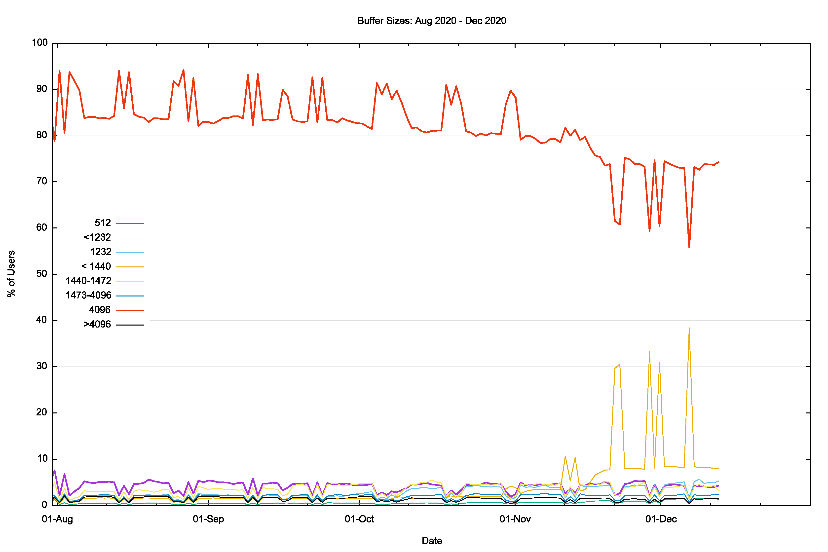
Flag Day 2020
August 2020 – December 2020
Use of 4,096 buffer size dropped from ~84% to 70% of users by December
Rise in 1,400 buffer size to 8% of users
Flag Day

Slide 8
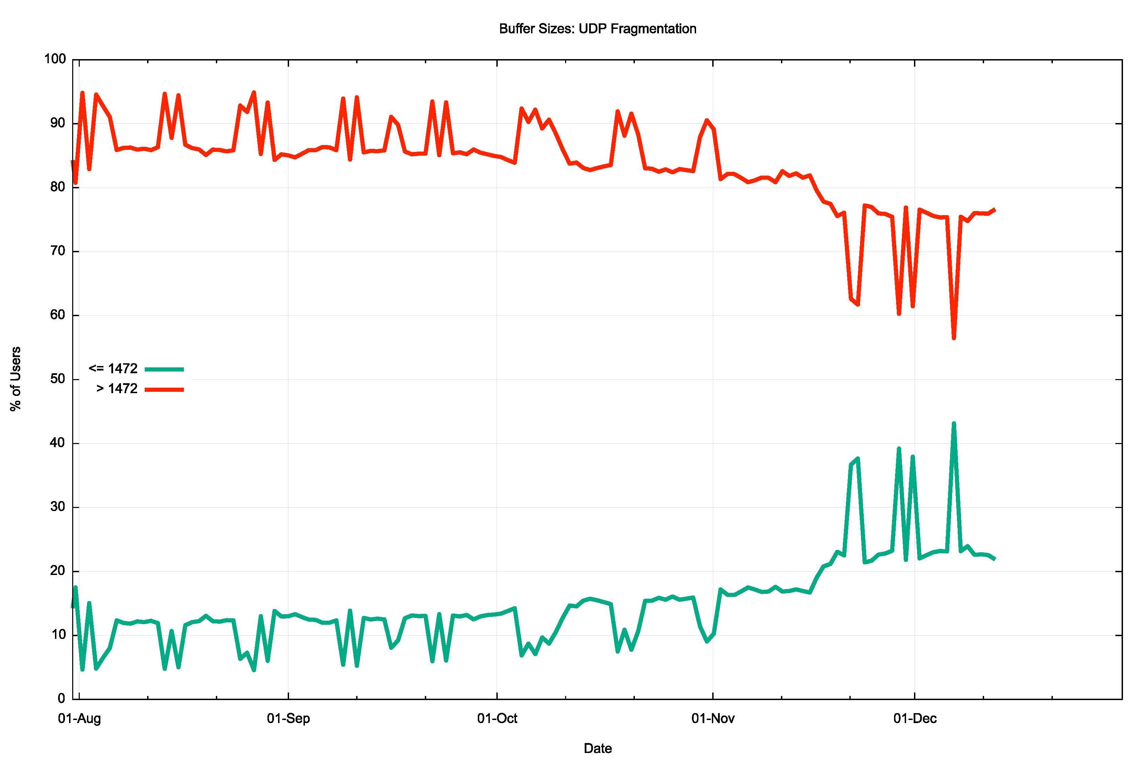
UDP Fragmentation
EDNS(0) UDP Buffer Size > MTU
August 2020 – December 2020
Fragmentation avoidance settings rose from 12% of users to ~22% of users
Flag Day
EDNS(0) UDP Buffer Size < MTU

Slide 9
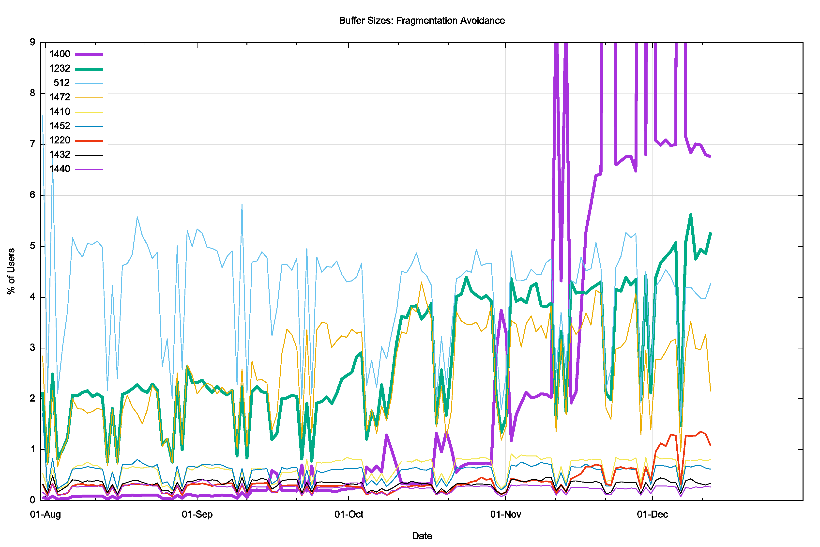
UDP Fragmentation Avoidance
Flag Day
August 2020 – December 2020
1,232 is now used by 5% of users
1,400 is now used by 7% of users
284 different sizes between 512 and 1472 observed in this data set

Slide 10
Pick a Size
Is there a “right” size for this parameter?
What are we attempting to achieve here when trying to select the threshold point to get the DNS to switch to use TCP?
Should we use a low value and switch “early”?
Should we use a high value and switch “late”?

Slide 11
IP and Packet Sizes
 | IPv4 | IPv6
Minimum IP Packet Size | 20 | 40
Maximum Assured Unfragmented Packet Size | 68 | 1,280
Assured Host Packet Size | <= 576 | <= 1,500
Maximum Packet Size | 65,535 | 65,575* | *4,294,967,336 (Jumbogram)

Slide 12
Some Questions
Why choose 1,232 octets as the threshold point to truncate a UDP response in Flag Day 2020?
How bad is UDP Fragmentation loss in the DNS?
How bad is TCP in the DNS?

Slide 13
Mesurement Challenges
How to perform a large scale measurement?
  We embed the measurement in an advertisement to distribute the measurement script to a broad set of test cases
How to detect DNS resolution success?
  We use a technique of “glueless” delegation to force a resolve to explicitly resolve the name of a name server – a successful resolution is signalled by the resumption of the original resolution task
How to characterise DNS behaviour?
  We pad the response to create the desired response size. Each test uses a response size selected at random from 11 pad sizes. We also use an unpadded short response as a control

Slide 14
Limitations
We are measuring the DNS path between recursive resolvers and the authoritative name servers. This is a measurement of the “interior” of the Internet. It is not a measurement of the stub-to-recursive paths at the edge of the network.
Some resolvers alter their behaviour when resolving name server names
  In some 30% of cases the EDNS(0) Buffer Size is either dropped from the query, or dropped below 1452 octets

Slide 15
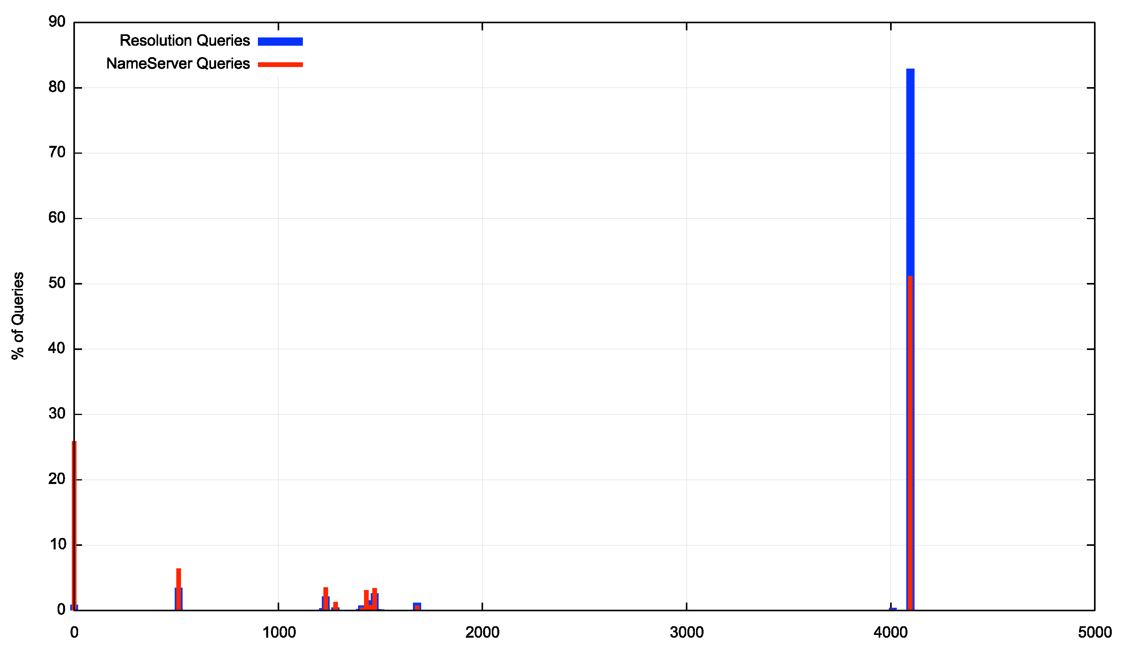
Limitations
In some 30% of cases the EDNS(0) Buffer Size is either dropped from the query, or dropped below 1452 octets

Slide 16
“Base Test” September 2020
Size | Tests |  | Passed | Failed | Rate
1230 | 4,303,845 |  | 4,282,457 | 21,388 | 0.50%
1270 | 4,308,667 |  | 4,287,046 | 21,621 | 0.50%
1310 | 4,307,456 |  | 4,286,064 | 21,392 | 0.50%
1350 | 4,304,230 |  | 4,282,752 | 21,478 | 0.50%
1390 | 4,310,182 |  | 4,288,413 | 21,769 | 0.51%
1430 | 4,303,906 |  | 4,281,858 | 22,048 | 0.51%
1470 | 4,308,722 |  | 4,269,785 | 38,937 | 0.90%
1510 | 4,303,923 |  | 4,197,910 | 106,013 | 2.46%
1550 | 4,306,824 |  | 4,194,465 | 112,359 | 2.61%
1590 | 4,300,559 |  | 4,187,575 | 112,984 | 2.63%
1630 | 4,305,525 |  | 4,191,994 | 113,531 | 2.64%
Onset of server UDP
fragmentation

Slide 17
TCP behaviour
This selects the subset of cases where the recursive resolver was passed a truncated UDP response, which should trigger the resolver to use TCP
Truncated UDP response, no followup TCP
Stalled TCP session with missing ACK from data segment
Completed TCP session but no signal of resumption of original resolution
Size | TCP Use |  | Pass | Fail |  | NO TCP | NO ACK | TCP OK
1230 | 9% |  | 98.7% | 1.3% |  | 11.4% | 28.3% | 60.3%
1270 | 13% |  | 99.0% | 1.0% |  | 12.2% | 27.7% | 60.1%
1310 | 13% |  | 99.0% | 1.0% |  | 13.2% | 26.4% | 60.4%
1350 | 13% |  | 99.0% | 1.0% |  | 13.0% | 27.9% | 59.0%
1390 | 14% |  | 99.0% | 1.0% |  | 15.2% | 27.1% | 57.7%
1430 | 14% |  | 99.1% | 0.9% |  | 15.7% | 25.9% | 58.5%
1470 | 30% |  | 98.5% | 1.5% |  | 9.2% | 58.3% | 32.5%
1510 | 36% |  | 98.1% | 1.9% |  | 22.7% | 47.2% | 30.1%
1550 | 36% |  | 98.1% | 1.9% |  | 23.2% | 46.8% | 30.0%
1590 | 36% |  | 98.1% | 1.9% |  | 24.5% | 45.7% | 29.8%
1630 | 36% |  | 98.1% | 1.9% |  | 25.6% | 45.5% | 28.9%
Responses which are larger than 1,430 octets show a higher loss rate

Slide 18
TCP behaviour
TCP shows a base failure rate of some 1% to 2% of tests
For smaller responses this may be due to enthusiastic filtering of TCP port 53 packets
For larger responses TCP “Black Hole” factors may be involved, as the server was configured to use a local 1,500 octet MTU and maximum size TCP data segments may have triggered Path MTU pathologies

Slide 19
Forcing TCP
Here we set the server’s max buffer size to 512, forcing all resolution attempts to use TCP
DNS Response Size | Tests | TCP Pass Rate | TCP Fail Rate | IPv4 Failure Rate | IPv6 Failure Rate
1150 | 1,104,539 | 98.5% | 1.6% | 1.9% | 1.6%
1190 | 1,105,126 | 98.5% | 1.6% | 1.9% | 1.6%
1230 | 1,105,601 | 98.5% | 1.6% | 1.9% | 1.6%
1270 | 1,104,571 | 98.5% | 1.6% | 1.9% | 1.6%
1310 | 1,104,521 | 98.5% | 1.6% | 1.9% | 1.6%
1350 | 1,104,068 | 98.5% | 1.6% | 2.0% | 1.6%
1390 | 1,105,080 | 98.5% | 1.6% | 1.9% | 1.6%
1430 | 1,104,527 | 98.5% | 1.6% | 1.9% | 1.6%
1470 | 1,103,423 | 98.3% | 1.8% | 2.1% | 1.8%
1510 | 1,104,960 | 98.3% | 1.8% | 2.1% | 1.8%
1550 | 1,105,566 | 98.3% | 1.8% | 2.1% | 1.8%
1590 | 1,103,609 | 98.3% | 1.8% | 2.1% | 1.8%
1630 | 1,106,284 | 98.3% | 1.8% | 2.1% | 1.8%
IPv4 shows a slightly higher failure rate than IPv6

Slide 20
UDP behaviour
This selects the subset of cases where the recursive resolver was not passed a truncated UDP response and did not attempt a TCP connection
Size | UDP Use |  | Pass | Fail
1230 | 91% |  | 99.6% | 0.4%
1270 | 87% |  | 99.6% | 0.4%
1310 | 87% |  | 99.6% | 0.4%
1350 | 87% |  | 99.6% | 0.4%
1390 | 86% |  | 99.6% | 0.4%
1430 | 86% |  | 99.6% | 0.4%
1470 | 70% |  | 99.4% | 0.6%
1510 | 64% |  | 97.2% | 2.8%
1550 | 64% |  | 97.0% | 3.0%
1590 | 64% |  | 97.0% | 3.0%
1630 | 64% |  | 97.0% | 3.0%
Onset of server UDP
fragmentation

Slide 21
UDP behaviour
UDP shows a base failure rate of some 0.5% to 3% of tests
For smaller responses this may be due to residual filtering of UDP port 53 packets greater than 512 octets in size
For larger responses UDP fragmentation is the likely factor where the buffer size permits the server to transmit fragmented UDP packets, but they appear not to reach the resolver client

Slide 22
Forcing UDP
Here we alter the server to treat all queries as if they had signalled a buffer size of 4,096 octets
DNS Response Size | Tests | UDP Pass Rate | UDP Fail Rate | IPv4 Failure Rate | IPv6 Failure Rate
1150 | 1,140,192 | 99.6% | 0.4% | 0.6% | 0.1%
1190 | 1,138,792 | 99.6% | 0.4% | 0.6% | 0.1%
1230 | 1,273,730 | 99.6% | 0.4% | 0.6% | 0.1%
1270 | 1,272,765 | 98.1% | 1.9% | 2.4% | 1.2%
1310 | 1,275,436 | 98.2% | 1.8% | 2.4% | 1.2%
1350 | 1,272,634 | 98.2% | 1.8% | 2.4% | 1.2%
1390 | 1,273,332 | 98.1% | 1.9% | 2.4% | 1.2%
1430 | 1,274,189 | 97.8% | 2.2% | 2.6% | 1.6%
1470 | 1,274,581 | 96.9% | 3.1% | 3.7% | 17.6%
1510 | 1,273,496 | 85.0% | 15.0% | 14.2% | 17.6%
1550 | 1,274,776 | 85.0% | 15.0% | 14.4% | 17.7%
1590 | 1,276,441 | 85.1% | 14.9% | 14.4% | 17.6%
1630 | 1,275,233 | 85.1% | 14.9% | 14.5% | 17.6%
Onset of server UDP
fragmentation

Slide 23
Forcing UDP
A number of resolvers will discard a DNS response if it is larger than the original buffer size
  This appears to occur in some 2% - 3% of cases
A number of resolvers do not receive fragmented UDP packets
  This appears to occur in ~11% of cases in IPv4, and ~15% of cases in IPv6

Slide 24
DNS Flag Day 2020
We appear to have repurposed the EDNS(0) Buffer Size parameter
  It was originally designed as a signal from the client to the server of the client’s capability to receive a DNS response over UDP
    Oddly enough no comparable signal was defined for TCP, even though, presumably, the same client-side memory limitations for DNS payloads would exist
  It appears to have been intended as a UDP mechanism that “can help improve the scalability of the DNS by avoiding widespread use of TCP for DNS transport.” (RFC 6891)
  The Flag Day measures appear to repurpose this parameter as a UDP fragmentation avoidance signal

Slide 25
DNS Transport Considerations
Unfragmented UDP is relatively fast, stable and efficient
  There is a slight increase in drop rates above 512 octets to around 0.5%
  There is no visible change in drop rates in payloads up to 1500 octets in size
Fragmented UDP has a very high drop rate
  Between 11% and 15% drop rate in IPv4 and IPv6 respectively
  It is more likely to be due to security filtering practice, although no specific fragmentation measurement has been made
TCP is less efficient and slower than unfragmented UDP, but far better in performance terms than Fragmented UDP
  Base failure rate for TCP is between 1% to 2% of cases

Slide 26
DNS Transport Priorities
Use unfragmented UDP as much as possible
Avoid dynamic discovery of path MTU / fragmentation onset
Prefer TCP over responding with fragmented UDP for larger responses

Slide 27
Buffer Size Considerations
One size fits all?
  1232 is a conservative value with a high assurance of fragmentation avoidance
  Early onset of TCP extracts a marginal cost in terms of efficiency and speed of resolution
  Could we improve on this by tailoring the value to suit the context of the query/response transaction?
Customised settings
  Fragmentation onset occurs in different ways on different paths
  Our measurements suggest that in the “interior” of the Internet between recursive resolvers and authoritative servers the prevailing MTU is at 1,500. There is no measurable signal of use of smaller MTUs in this part of the Internet *
  Fragmentation onset occurs differently for IPv4 and IPv6
* The “edge” of the internet is likely to be different – no measurements were made for edge scenarios in this study

Slide 28
For Recursive to Authoritative
Our measurements suggest setting the EDNS(0) Buffer size to:
  IPv4 1,472 octets
  IPv6 1,452 octets
A small additional performance improvement can be made by using a lower TCP MSS setting – our measurements of a 1,200 octets setting showed a small but visible improvement in TCP resilience for large (multi-segment) payloads. In the TCP the marginal cost of a highly conservative setting for the MSS is far lower than the cost of correcting MTU issues.

Slide 29
Thanks!
Full Report: https://www.potaroo.net/ispcol/2020-11/xldns.html (part 1)
https://www.potaroo.net/ispcol/2020-12/xldns2.html (part 2)

